Slide 1
LINE Notification Tool

Slide 2
Implementation
Crawling Data from Facebook Group
Line Notify
Flex
MySQL
Line Message API
TF-IDF Algorithm – extract keywords
Word Cloud
LIFF

Slide 3
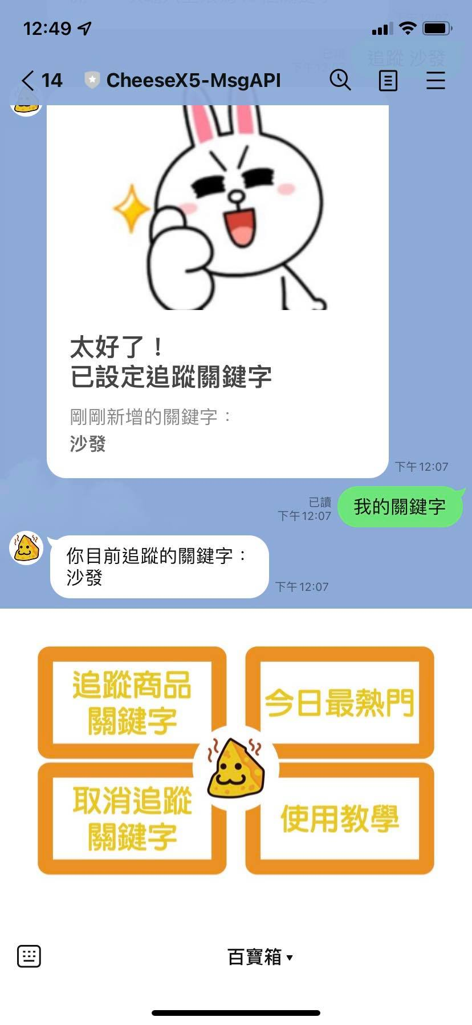
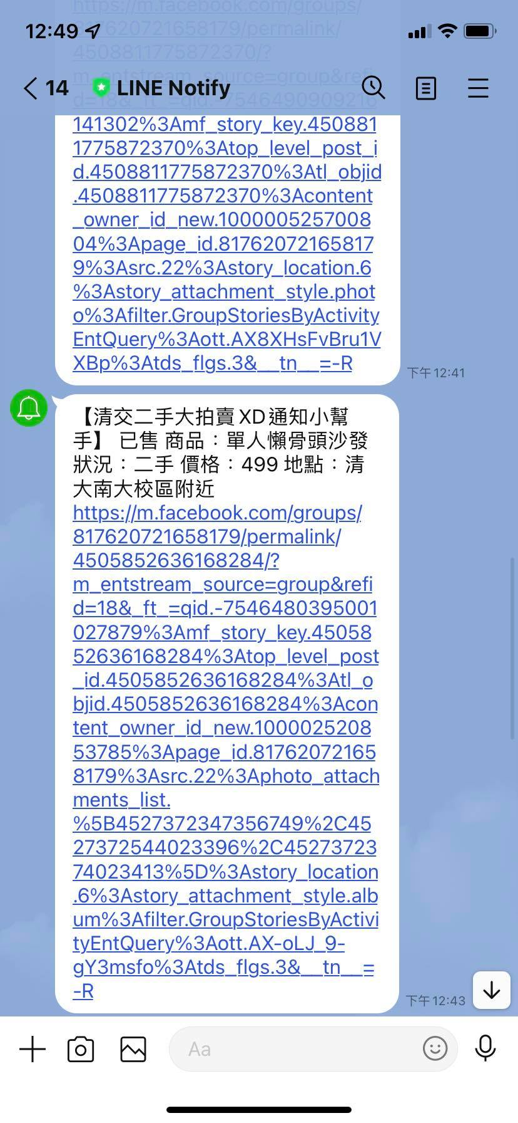
Functionality

